Slide 1

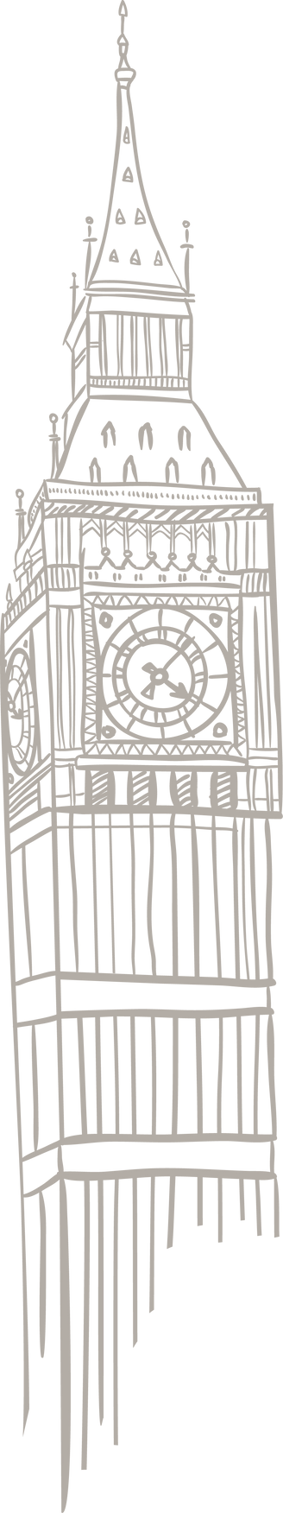

THE JUNIOR MODEL UNITED NATIONS

Slide 2



JMUN
Do you...
-want to learn about important global issues?
-learn how to express your ideas?
-take part in real, challenging ideas?
-learn lifelong skills and experience?

Slide 3

WHAT IS THE U.N?
United Nations (UN) is an international organization which works to achieve world peace.

Slide 4

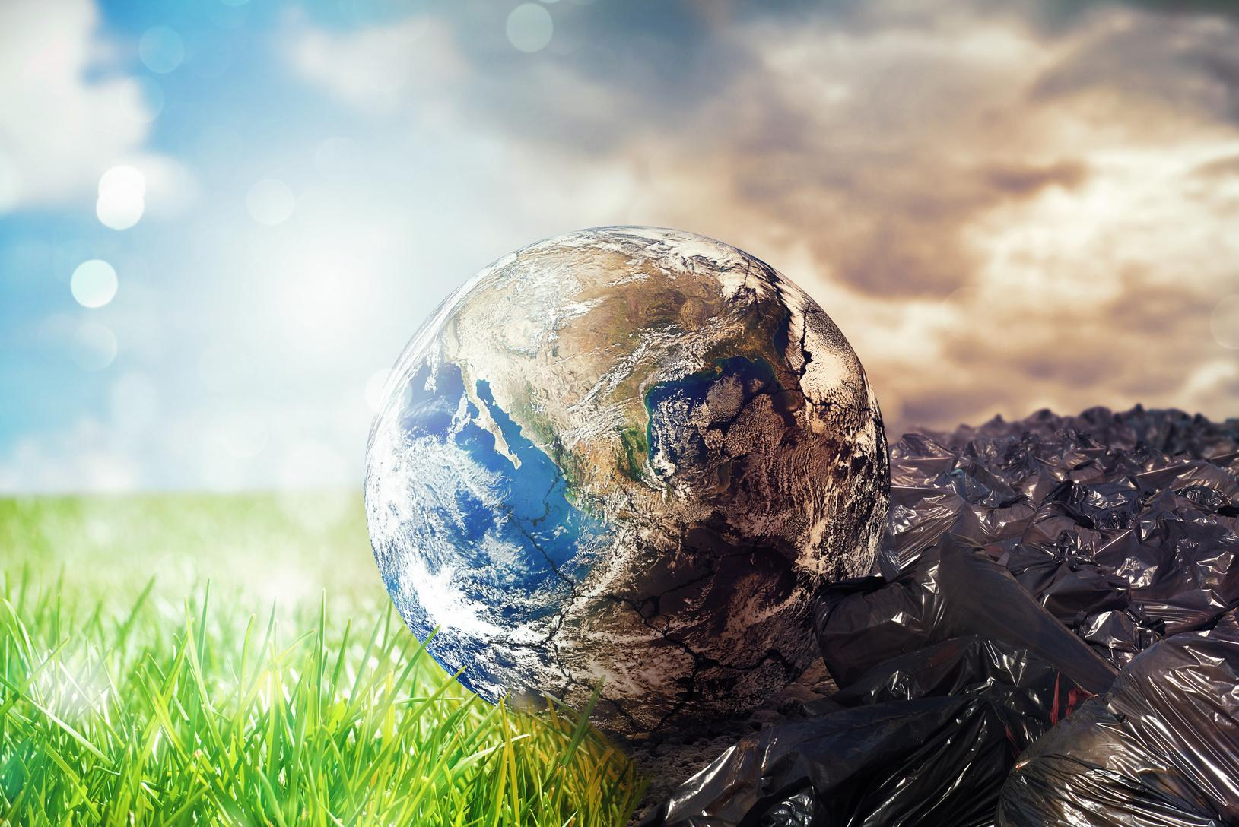
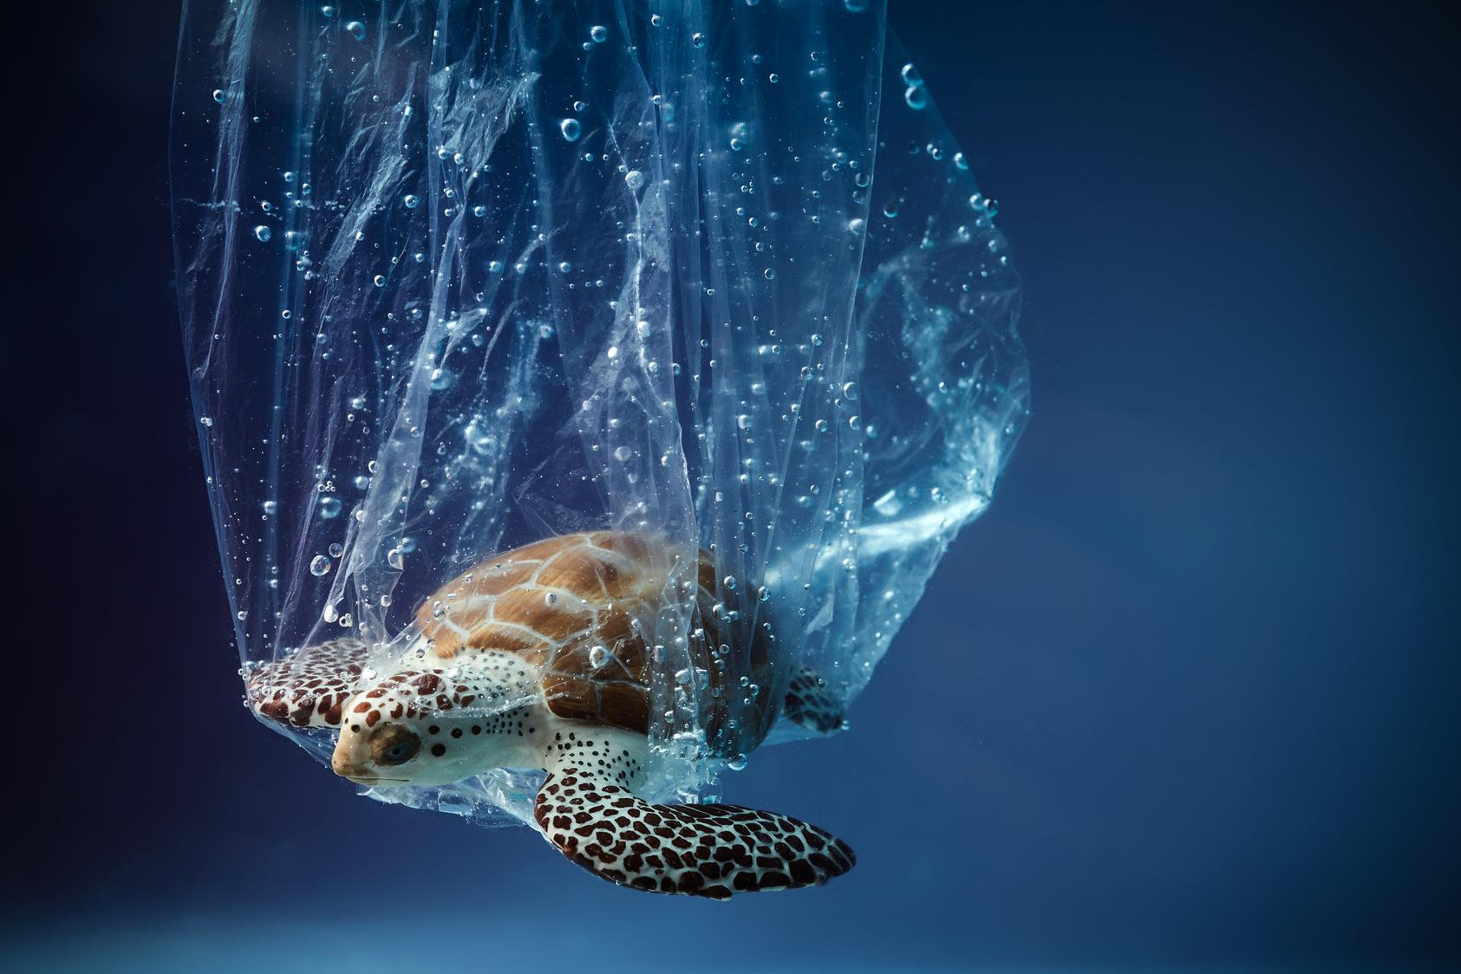
  Model United Nations (MUN) is an activity held in schools all around the world, where students simulate the real United Nations.
  It is usually held for one or more days. JMUN is a unique event since it is organized for middle-school students.

Slide 5
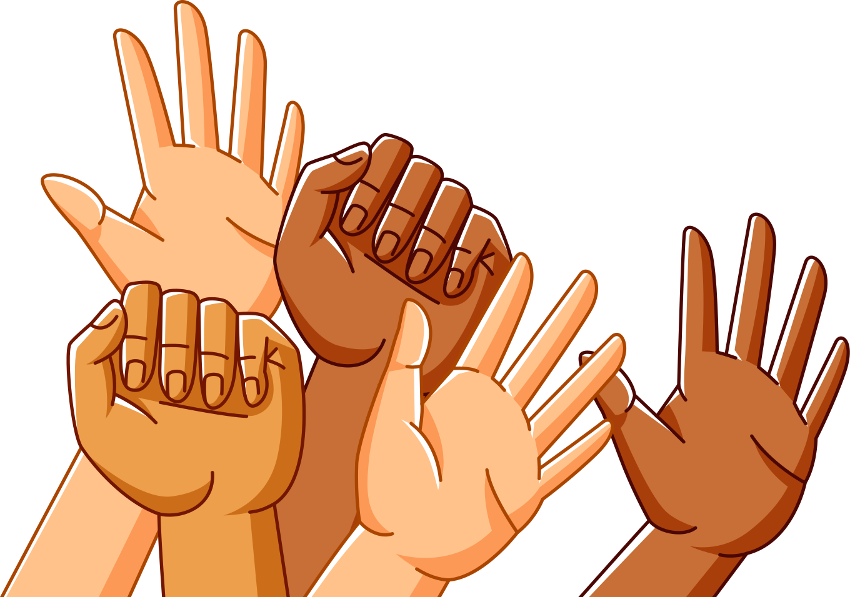
FOUR MAIN PURPOSES
  To keep peace in the world,
  To develop friendly relations among nations,
  To work together to improve lives of poor people, to conquer hunger, disease and illiteracy and to encourage respect for each other’s rights and freedoms,
  To be a center for uniting the actions of nations to achieve these goals.

Slide 6
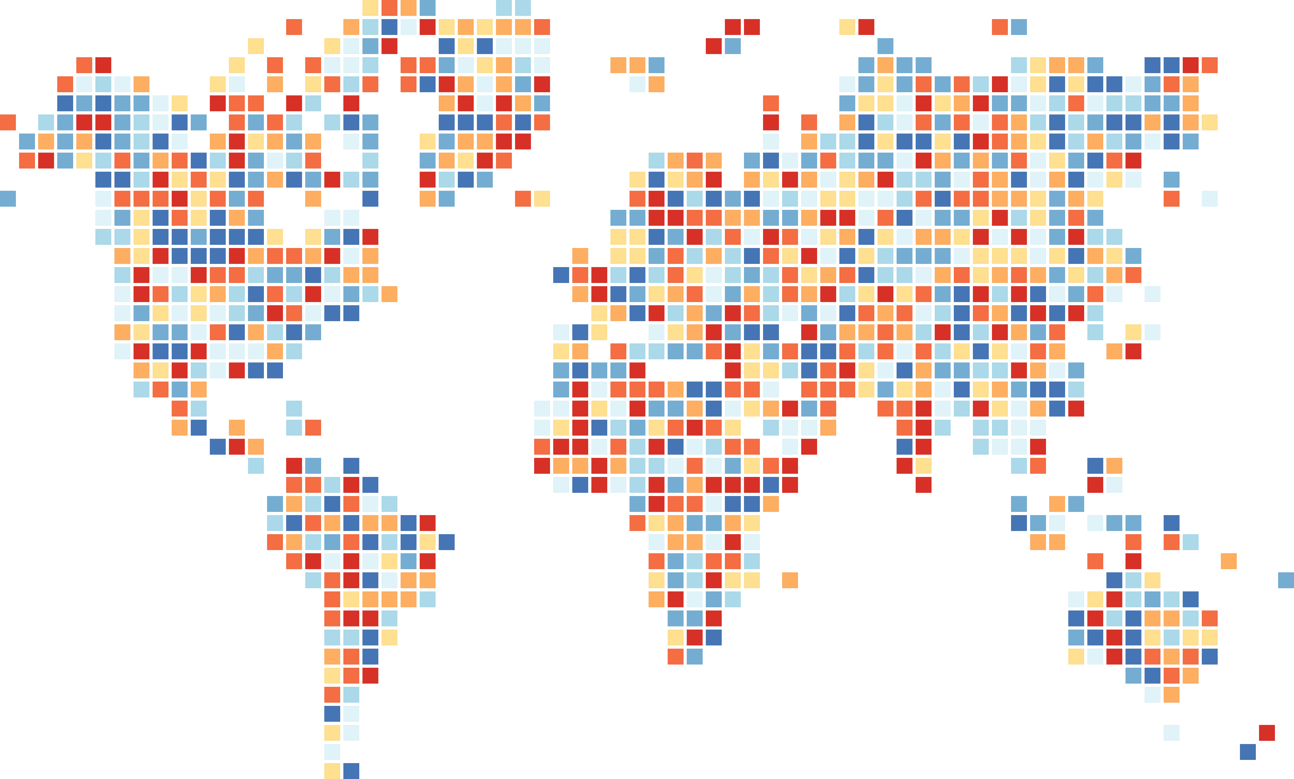
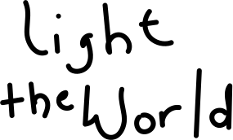
WHAT IS the JMUN?
Junior version of Model United Nations
Designed for middle school students

Slide 7
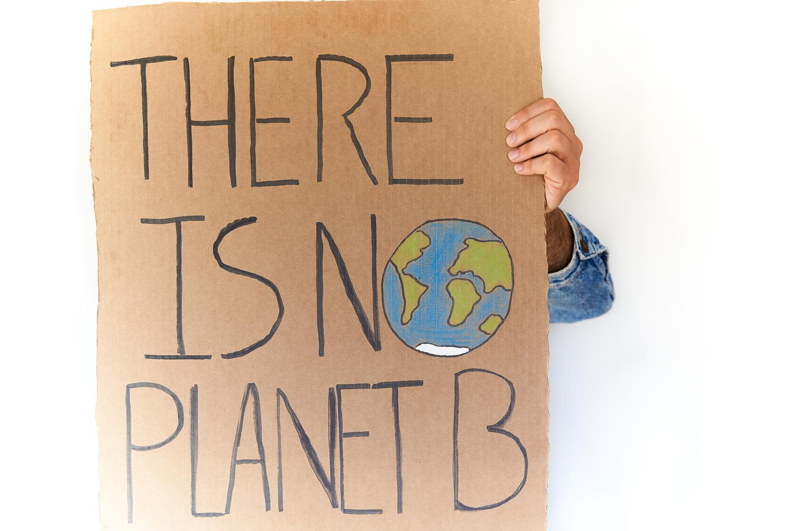
MAIN GOALS
-to improve writing and speaking skills in English
-equip students with useful skills to discuss world issues on peace, civil war, hunger, economic issues etc.
-prepare students as future delegates at MUN conferences.

Slide 8

SOME WORDS
YOU NEED TO KNOW
Delegate: A member of UN committee
Delegation: The entire group of people in the UN committee.
Member State: The countries that send delegations to UN meetings.

Slide 9
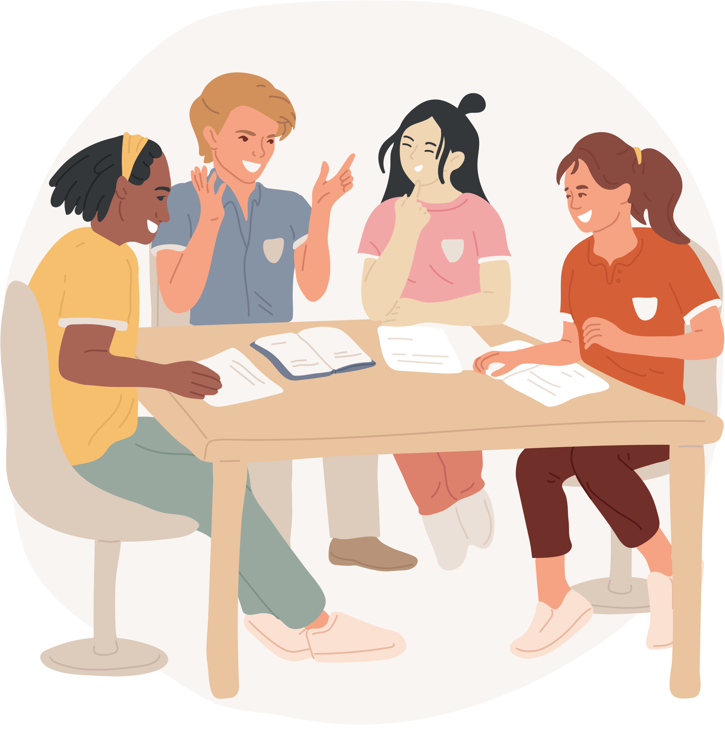
How will our club sessions work?
  Role-play of a real UN meeting.
  We also will...
-debate real world issues.
-work together to try to find a resolution,
a way to help solve these problems.

Slide 10
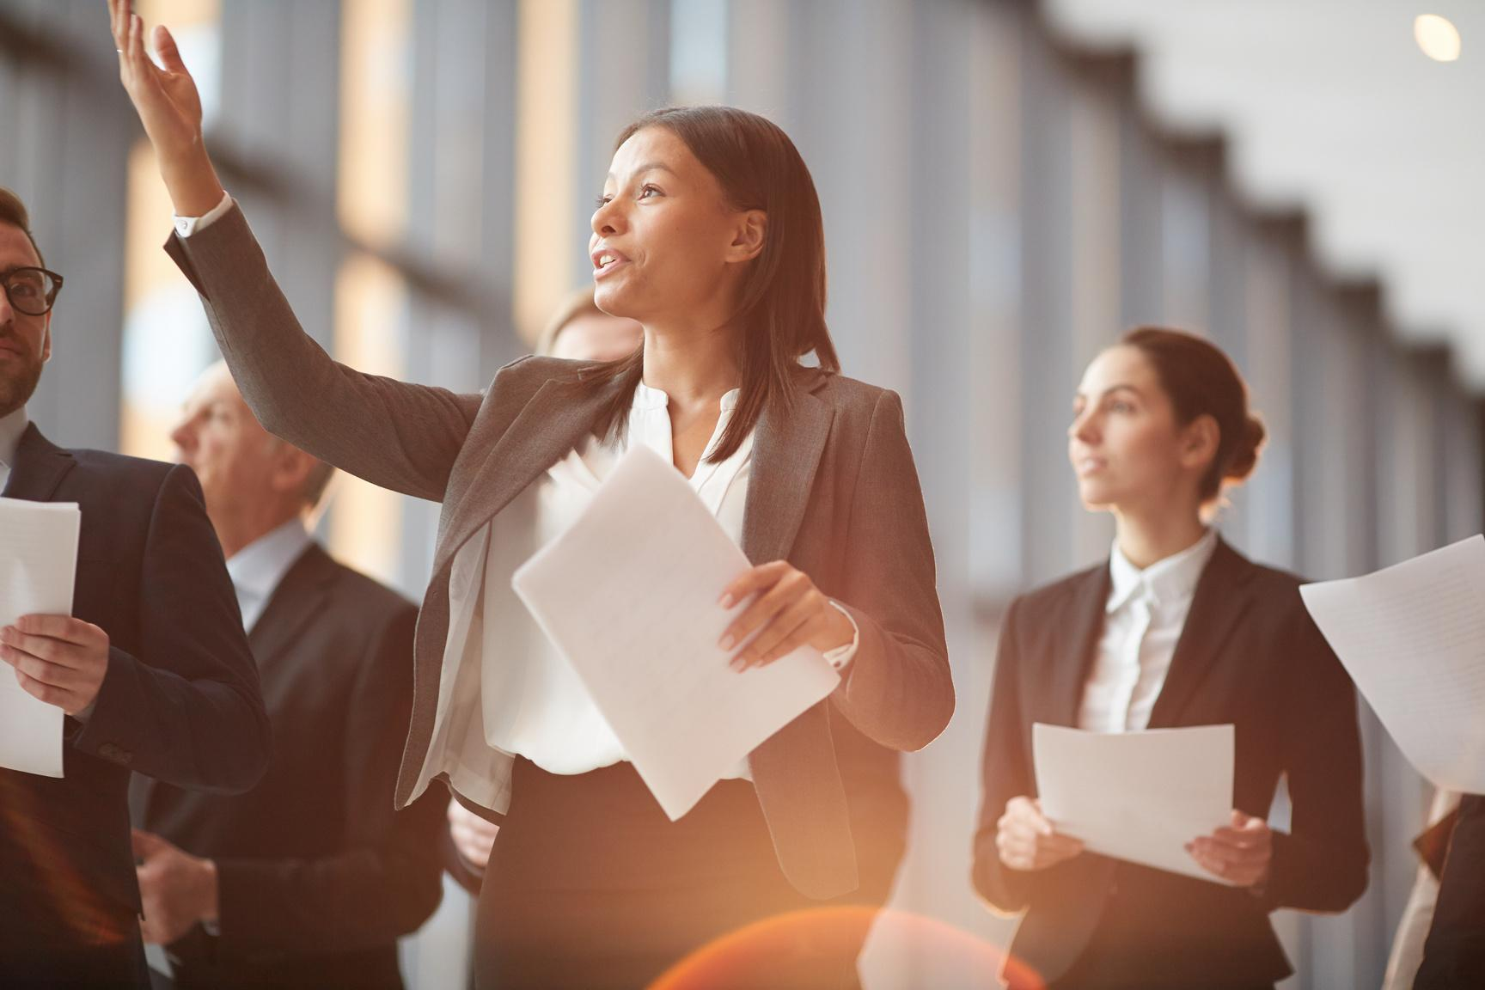
  You will be a delegate in a model UN meeting.
  You will be given a UN Member State. You will act in the role of that country’s diplomats.
  You will represent the views of ‘your’ country, reflecting that country’s national interests.
WHAT WILL I DO?

Slide 11
The delegates will
  research their country’s position on a topic.
  research their country’s perspective on the topics that will be discussed at the Model UN.
STEP 1:
RESEARCH

Slide 12
The delegations:
  come together at the UN meeting and follow rules of procedure that they have agreed on.
  present statements of their countries’ positions and debate.
  negotiate with the other delegations, in formal and informal debates
STEP 2:
THE MEETING

Slide 13
The delegates:
  come together to write a resolution, which reflects each country’s interests.
  vote on the resolution and the changes.
  produce a final resolution, which the majority of delegations agree on.
STEP 3:
THE RESOLUTION

Slide 14



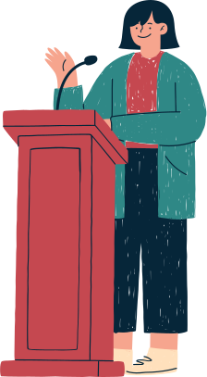

What skills you will learn?
RESEARCH
AWARENESS
DEBATING
PRESENTATION

